Slide 1
Presentation on Face Recognition using Siamese Networks By Prathamesh Bhaskar –A- 22111077- 411005 Prajwal Rahte –A - 22110942- 411047 Roshan Jadhav –A- 22220205- 411019 Yash Patil –A- 22110340- 411079 Subject : Computer Vision
Guided by
DR. Yogesh Dandwate Sir
Department of Electronics and Telecommunications
Vishwakarma Institute of Information Technology , Pune

Slide 2
Outline
Introduction
Motivation
Literature Survey
Objectives
Methodology
Dataset
Implementation
Results
Conclusions
References

Slide 3
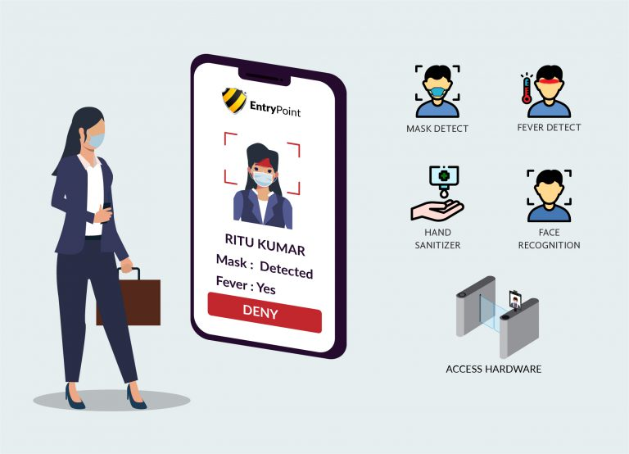
Introduction
Innovative Fusion of AI and Computer Vision: This project represents a pioneering fusion of artificial intelligence and computer vision, focusing on implementing a Face Recognition System using Siamese Networks.
Revolutionizing Face Recognition Accuracy: Leveraging deep learning algorithms, our system aims to significantly improve face recognition accuracy compared to traditional methods.
Versatility in Challenging Conditions: The system is designed to work efficiently in various real-world scenarios, handling challenges such as lighting variations, facial expressions, and partial occlusions.
Advanced Data Management: To ensure efficient data processing and storage, our solution integrates with reliable data management systems, making it suitable for both small-scale and large-scale applications.

Slide 4
Motivation
Accurate Face Recognition: To enhance the accuracy of face recognition systems using Siamese networks, overcoming the limitations of traditional methods.
Touchless and Efficient Identification: To develop a system that offers a safe, touchless, and convenient way of recognizing faces, especially in environments where contactless interaction is crucial.
Scalability and Adaptability: To create a solution that can be scaled to different use cases, including small groups and large organizations.
Privacy and Data Security: To ensure the system adheres to data privacy regulations, maintaining user confidence and security.

Slide 5
Literature Survey
Reference | Summary
Gregory Koch.,Department of Computer Science, University of Toronto[1] | Investigates Siamese neural networks for image recognition in one-shot learning scenarios. Utilizes CNN architectures to extract discriminative features, achieving near state-of-the-art accuracy in classification tasks, highlighting a potential avenue for future research.
Waquar ahmad.,International Journal of Computer Science Issues[2] | Proposes a face recognition-based attendance system using classroom cameras for automatic attendance marking, addressing the limitations of manual methods and the shortcomings of existing automated approaches.
Yaniv Taigman., Facebook AI Research, Menlo Park, CA, USA[3] | Examines the network's bottleneck layer as a crucial regularizer, identifying a performance saturation point with increased training data. Explores representation layer vulnerabilities and their link to uncertainty in the presence of distortions. Compares academic and commercial face recognition systems, suggesting broader implications for large-scale learning tasks beyond face recognition.
Florian Schroff., Google Inc.[4] | Introduces Face Net for efficient face verification and recognition by learning a mapping to a compact Euclidean space. Utilizes deep convolutional networks to optimize embeddings directly, achieving exceptional accuracy on benchmark datasets.

Slide 6
Objectives or Aim and Objectives
Aim – To develop a robust and scalable face recognition system using Siamese networks that accurately identifies individuals while maintaining data security and user privacy.
Objectives –
Accuracy Improvement: Implement Siamese networks to increase face recognition precision, reducing false positives and negatives.Train the system on diverse datasets to improve performance under varying conditions (lighting, expressions, etc.).
Seamless Integration: Combine deep learning algorithms with computer vision techniques to build a reliable and efficient recognition system.Integrate real-time face recognition capabilities suitable for real-world applications.
System Scalability: Ensure the model can adapt to various scales, from small user groups to large databases.Optimize computational efficiency to facilitate rapid recognition, even with extensive datasets.
Data Privacy and Compliance: Implement secure data handling protocols to protect sensitive user information.Follow data privacy guidelines to build a system that users can trust.
Real-World Usability: Design a user-friendly interface for ease of use across different applications.Test the system in real-world scenarios to validate its robustness and efficiency.

Slide 7
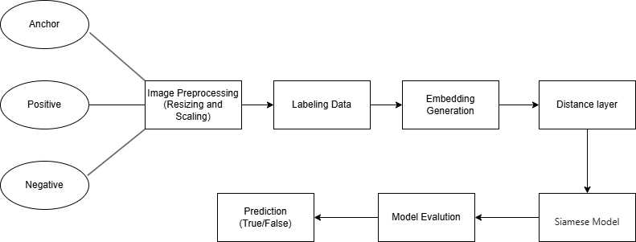
Block Diagram

Slide 8
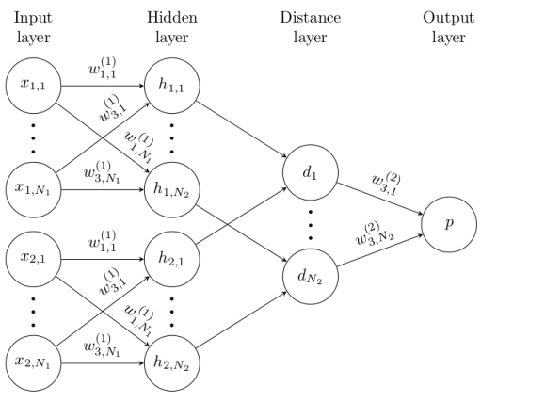
Methodology
Overview of Siamese Neural Network

Slide 9
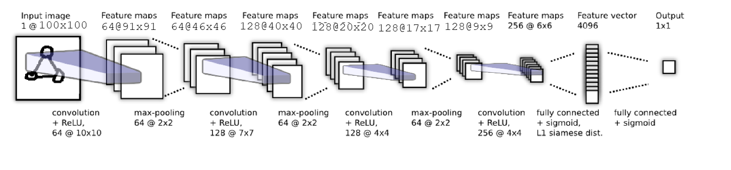
Architecture Diagram Siamese Network

Slide 10
Implementation
Dataset Preparation:
Collected facial image pairs (positive: same person, negative: different people).
Applied preprocessing resizing, grayscale conversion, and normalization.
Model Architecture:
Designed a Siamese Neural Network with twin CNN branches.
Each branch extracts feature embeddings from input images.
Loss Function:
Used Contrastive Loss to minimize distance between embeddings of similar faces and maximize it for dissimilar ones.
Training Phase:
Trained on a labeled dataset using paired inputs.
Implemented data augmentation to enhance generalization.
Testing and Evaluation:
Tested model on unseen face pairs to evaluate similarity scoring.
Achieved high accuracy in face verification tasks.

Slide 11
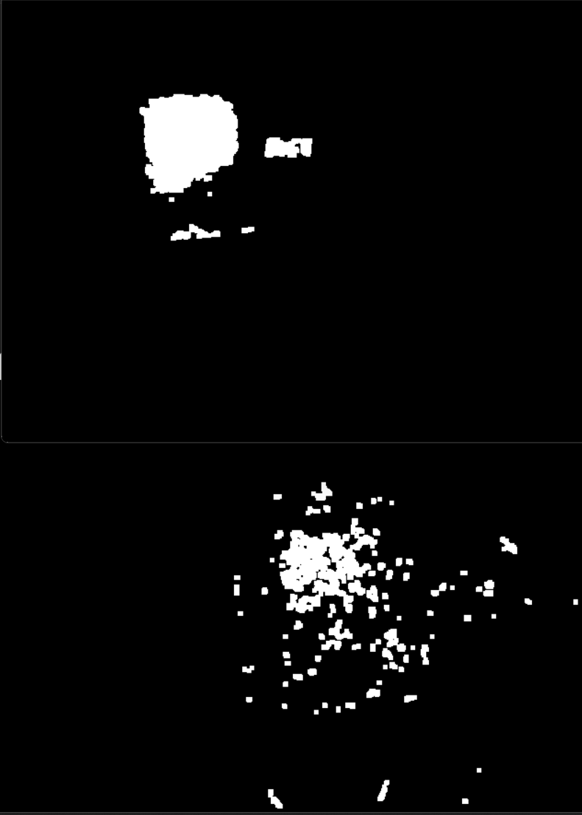
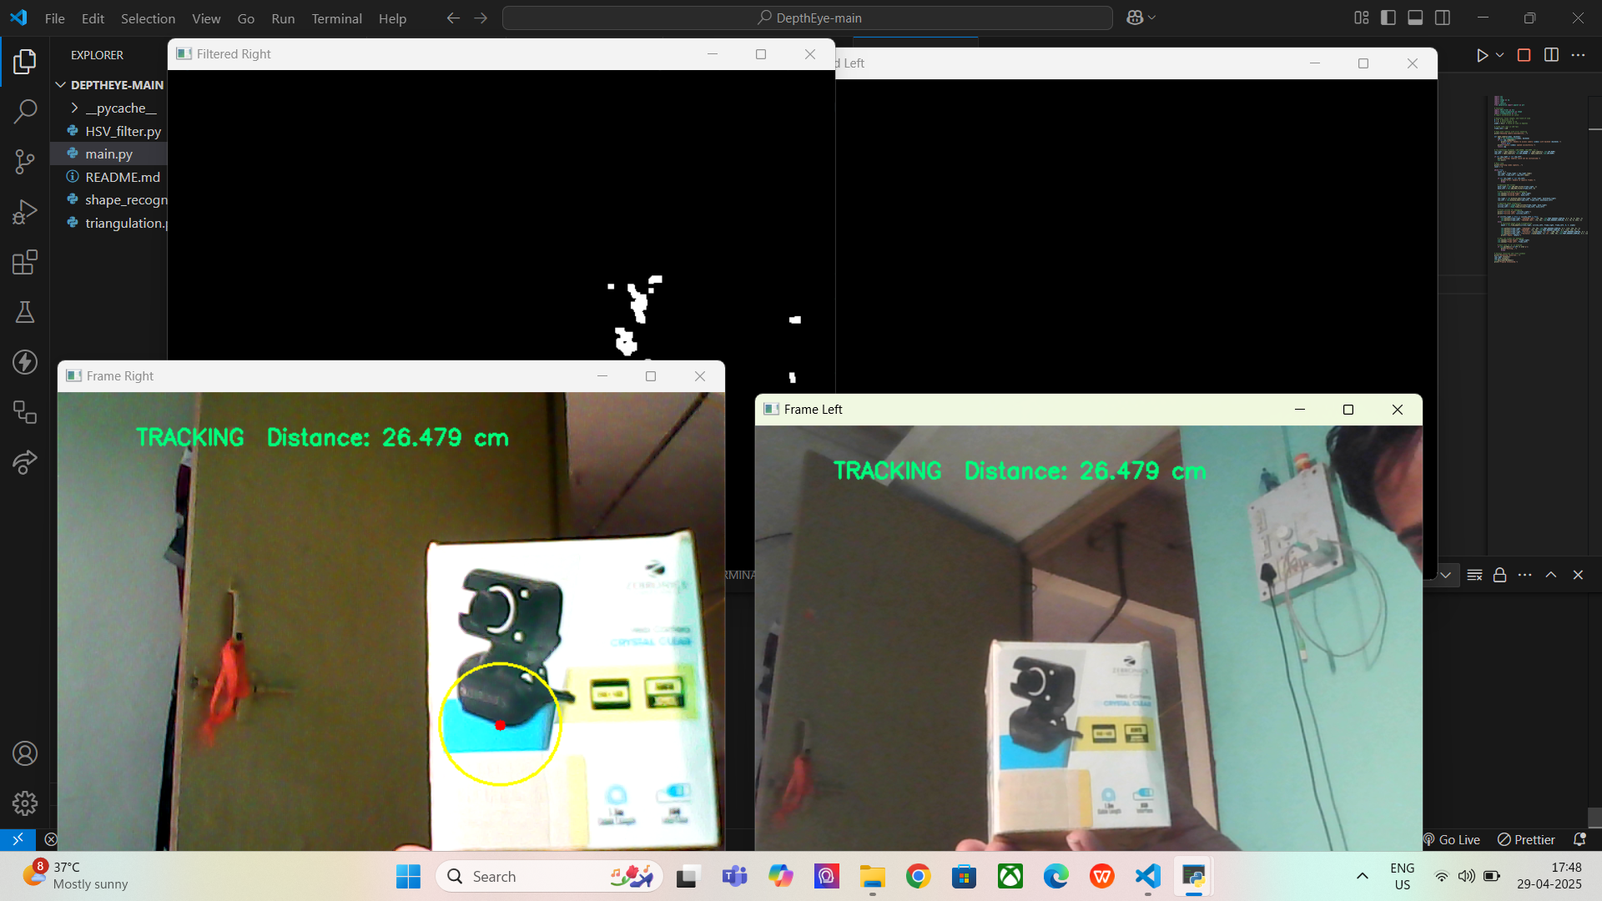
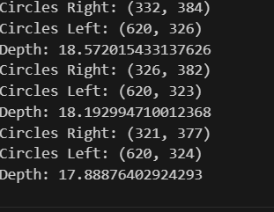
Results

Slide 12
Conclusion
Advanced Face Recognition: The project successfully demonstrates the potential of Siamese Networks in enhancing the accuracy of face recognition systems, offering a more reliable and efficient solution compared to traditional methods.
Touchless and Scalable Solution: By leveraging deep learning techniques, our system ensures touchless identification, making it ideal for diverse environments and applications while maintaining scalability for both small and large user groups.
Data Privacy and Compliance: The system is designed with data privacy in mind, following best practices for secure data handling to maintain user trust and adherence to regulations.
Future Prospects: The robust and adaptable architecture makes this system a promising foundation for future developments, including real-time recognition and integration with existing security systems.

Slide 13
References
[1] Siamese Neural Networks for One-shot Image Recognition- Gregory Koch, Richard Zemel , Ruslan Salakhutdinov. Department of Computer Science, University of Toronto. Toronto, Ontario, Canada.
[2] Algorithm for Efficient Attendance Management: Face Recognition based approach- Waquar ahmad, Muhammad Iram Baig, Naveed khan Baloch, International Journal of Computer Science Issues
[3] Deep Face: Closing the Gap to Human-Level Performance in Face Verification-Yaniv Taigman, Ming Yang, Marc' Aurelio Ranzato, Lior Wolf, Facebook AI Research Menlo Park, CA, USA
[4] Face Net: A Unified Embedding for Face Recognition and Clustering - Florian Schroff, Dmitry Kalenichenko, James Philbin. Google Inc.
[5] A brief history of Facial Recognition, NEC, New Zealand,26 May 2020.[Online]. Available:https://www.nec.co.nz/market-leadership/publications-media/a-brief-history-of-facialrecognition/
[6] Face detection,TechTarget Network, Corinne Bernstein, Feb, 2020.[Online]. Available: https://searchenterpriseai.techtarget.com/definition/face-detection.
[7] Paul Viola and Michael Jones, Rapid Object Detection using a Boosted Cascade of Simple Features. Accepted Conference on Computer Vision and Pattern Re cognition, 2001.
[8] Face Detection with Haar Cascade,Towards Data Science-727f68dafd08,Girija Shankar Behera, India, Dec 24, 2020.[Online]. Available: https://towardsdatascience.com/face-detectionwith-haar-cascade-727f68dafd08.
[9] Face Recognition: Understanding LBPH Algorithm,Towards Data Science90ec258c3d6b,Kelvin Salton do Prado, Nov 11, 2017.[Online].Available:https://towardsdatascience.com/face-recognition-how-lbph-works-90ec258c3d6b.
[10] What is Facial Recognition and how sinister is it, Theguardian, IanSample, July, 2019. [Online]. Available: https://www.theguardian.com/technology/2019/jul/29/what-is-facialrecognition-and-how-sinister-is-it.

Slide 14
THANK- YOU

